Slide 1
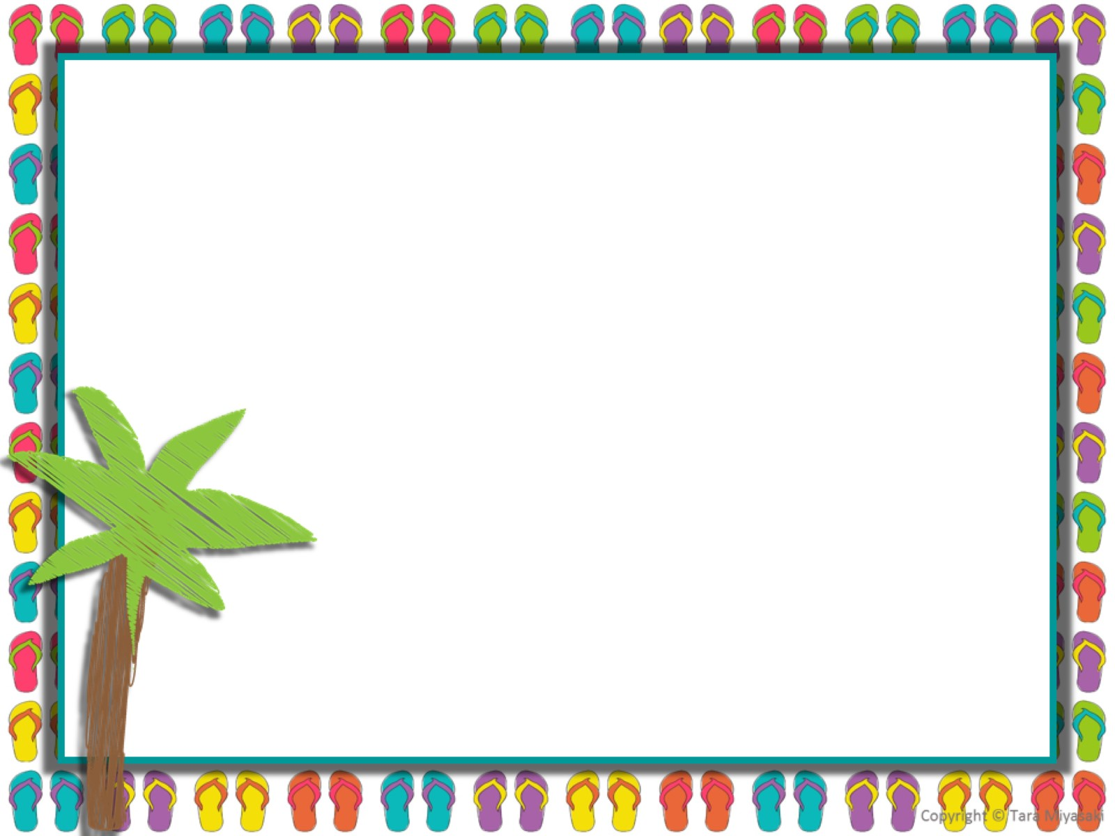
Unit 4 Math Review
Multiplying and Dividing Fractions

Slide 2
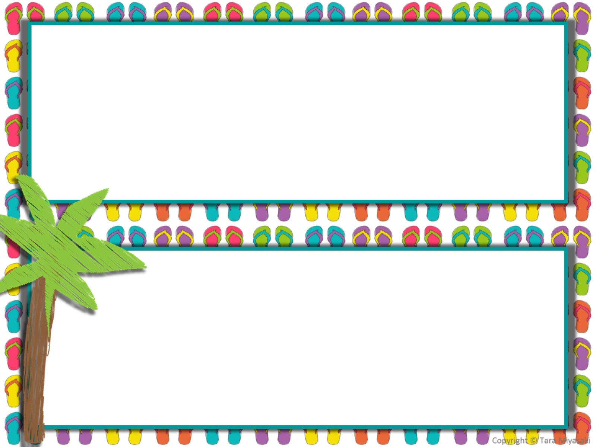
Without multiplying, determine which of the following products is/are less than 35. Select all that apply.
A. 35 x 3⅕
B. 35 x ⅛
C. 1/35 x 5/15

Slide 3
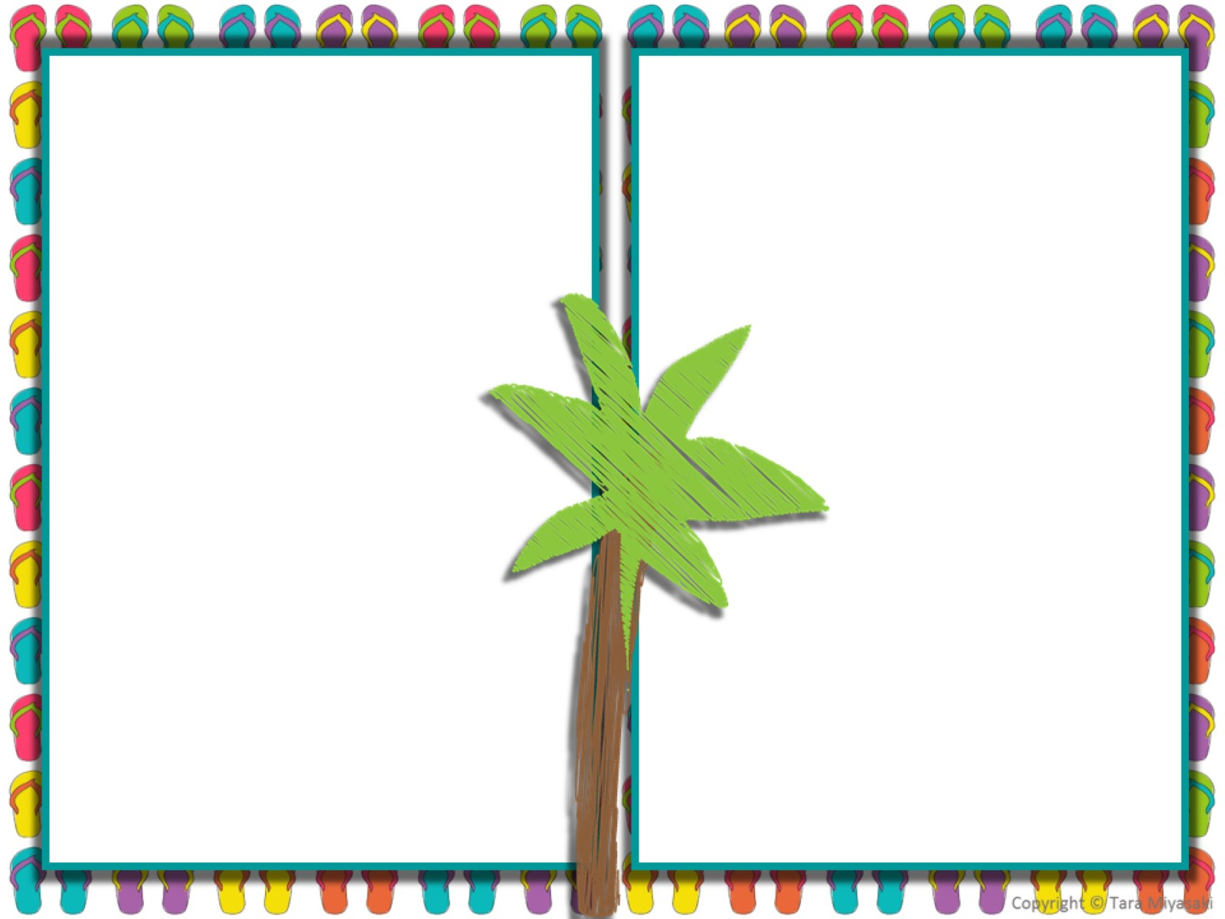
A. ⅖ = 5-2
B. ¼ = 4÷1
C. ⅞ = 8x7
D. ⅚ = 5÷6
2. Which of the following is a true statement?

Slide 4
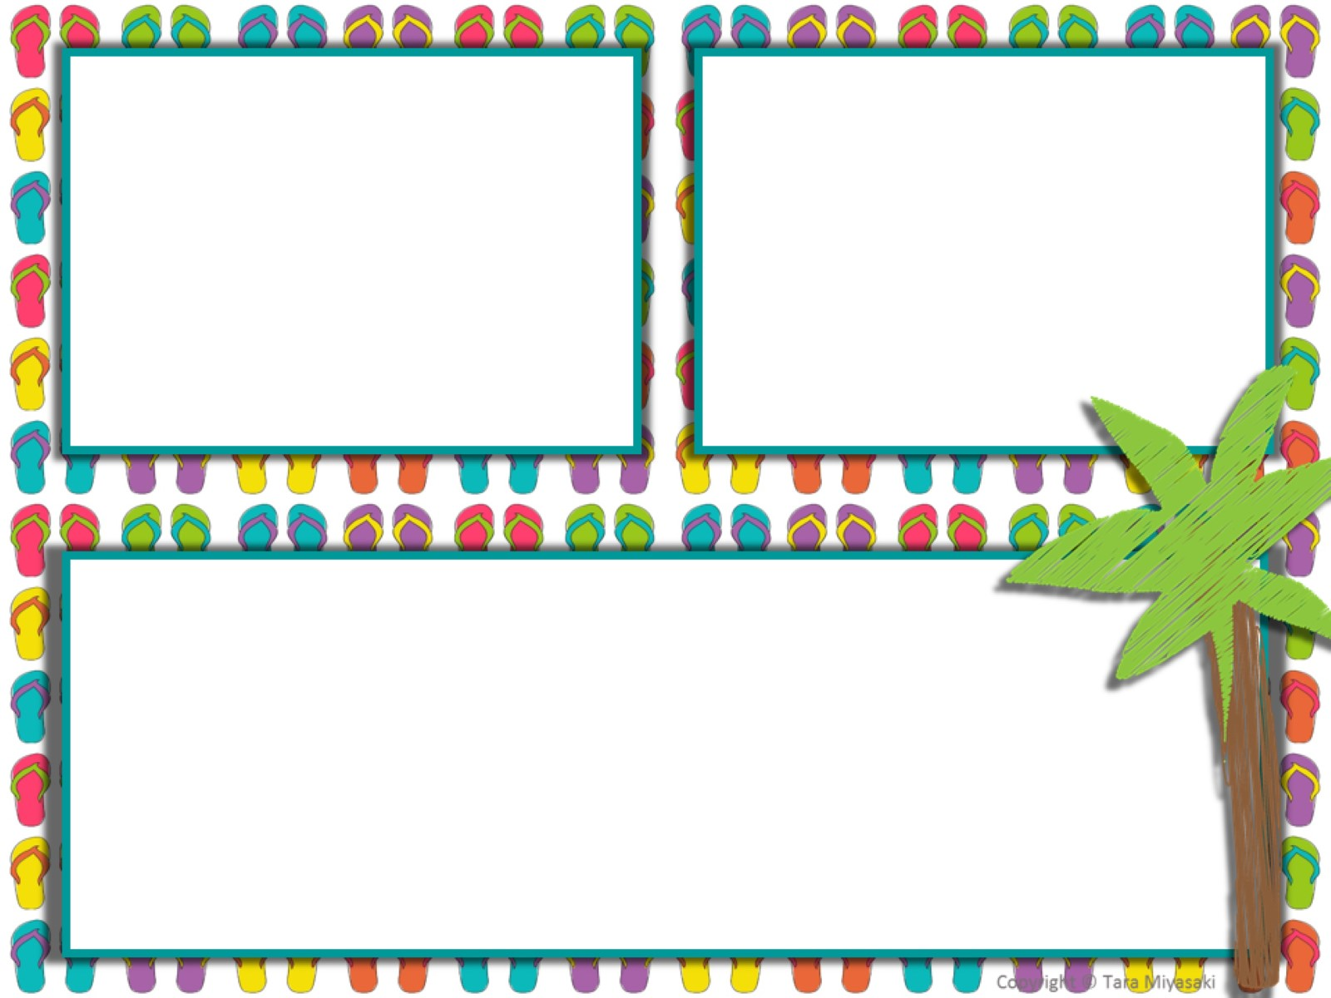
3. Sammy has 10 chocolate chip cookies. He is going to share them with 3 of his friends. Sammy doesn’t want any. How many cookies does each friend get?
A box of candy weighs 4 pounds. If Tommy has ¼ of a box, how many pounds of candy does he have?
pounds
Find the quotient.
⅜ ÷ 5

Slide 5
6. Use the rectangle to solve the problem.
5⅔ meters
⅝ meters
Enter the area, in square meters, of the rectangle.

Slide 6
Which of the following situations results in an answer of ¾? Select all that apply.
Three apples are split among 4 people. How much of an apple does each person receive?
Three gallons of water are needed to fill 4 fish tanks of equal size. How many gallons of water are required for each tank?
Three bags of bird seed are slip among 5 parrots. What fraction of a bag does each parrot have?
Four cats share 3 cans of tuna. How much of a can does each cat receive?
Four cupcakes are divided among 3 children. How much of a cupcake does each child receive?
Four dogs each drink 3 cups of water. How many cups of water do the dogs drink in all?

Slide 7
8. Create a multiplication and division problem that has an answer of 24?

Slide 8
9. Sandra has a bucket that holds a ½ gallon of water. How many buckets would she need to fill a tub that holds 24 gallons of water?

Slide 9
Look at the model.
➔
Enter the missing fraction to show what multiplication problem is represented by the shaded portion of the model.
4 x

Slide 10
Find the quotient.
12. Find the quotient.
⅘÷7
⅜÷5

Slide 11
13. There are 32 brownies on the table. If 7 children equally divide the brownies, how many brownies will they each get?

Slide 12
14. A bird gets ⅓ cup of food each morning. How many cups of food will the bird get over 6 mornings?

Slide 13
15. Lisa has a piece of wood that is in the shape of a rectangle.
⅖ yard
⅘ yard
What is the area of the piece of wood that Lisa has?
____________ square yards

Slide 14
16. Lisa baked 6 cakes for the Carpenter School Bake Sale. She is going to cut each cake into ¼ size pieces to sell. Lisa is trying to find how many cake slices she will have to sell.
Part A:
The squares represent the 6 cakes. Use the picture to show how many slices Lisa will have to sell.
How many slices will Lisa have to sell?
Part B:
Write an expression to show how many slices Lisa will have to sell.

Slide 15
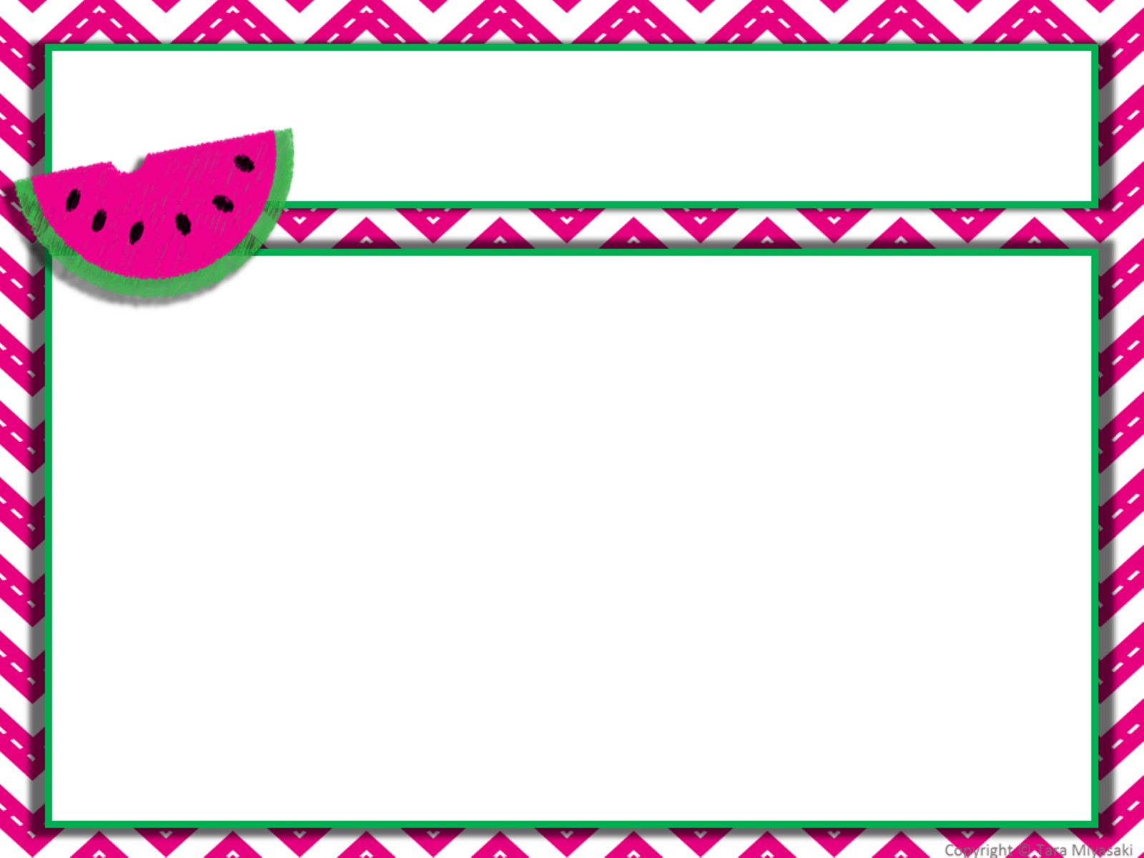

Slide 16
